Slide 1

SMIF Semantics
Semantic grounding of SMIF using ERGO
Cory Casanave, Model Driven Solutions
2018

Slide 2
SMIF Progress
Effort has focused on implementation
NoMagic – Cameo Concept Modeler
Model Driven – Federation Engine
SMIF has evolved and been improved as part of implementation, but the basic framework and structure is largely unchanged
Specification
Improvement and mapping of the UML profile to description logic, Jim Logan will present
Meta model and formalization using ERGO, this presentation

Slide 3
Some SMIF model changes
Refinement of context and propositions
Some items removed such that the language does not commit to:
Situations - States and occurrences, including their types.
Temporal Entity
However SMIF models may define such concepts
Refinement of property based restrictions – works better with DL

Slide 4
Semantic Grounding

Slide 5
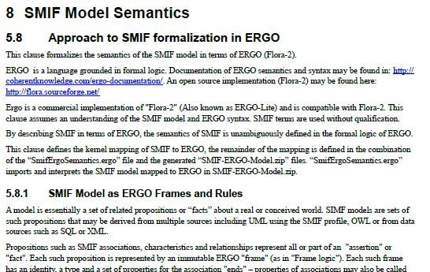
New clause of SMIF specification

Slide 6
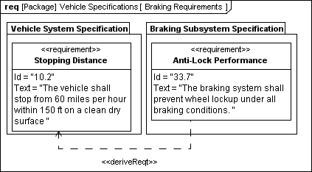
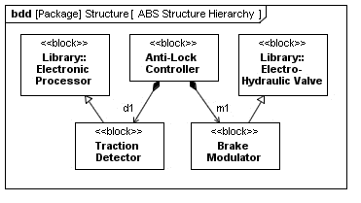
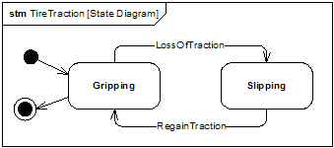
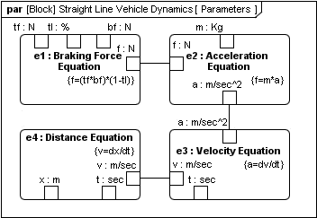
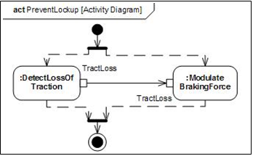
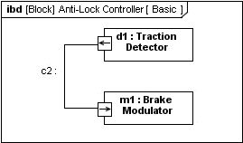





Problem: Uniform Interpretation
Using Modeling
Language
Model
«executes»
«interprets»
«interprets»
SysML
Semantics
SysML
Semantics
Interpreting the
Model
«implementedBy»
Manually
Automatically
«controlledBy»
«controlledBy»
«implementedBy»
Things
Being Modeled
‘Real World’
Source: Conrad Bock, SysML-2 Semantics

Slide 7
Goals for Semantic Grounding
Can represent all SMIF semantics with sufficient expressiveness
Higher order (context), full (n-ary) predicate logic and relationships, negation as failure (open or closed world), defaults, defeasible reasoning, temporality, relationships with identity
SMIF is about federating data, real data is messy
Description logic is insufficient for real-world federation
Does not over-commit
E.g. proof theory (unwanted inference)
Open / closed world
Monotonic / Non-monotonic
Can validate SMIF models
Can execute the semantics – model and mapping implications
An executable specification!
Openly available implementation
Practical!

Slide 8
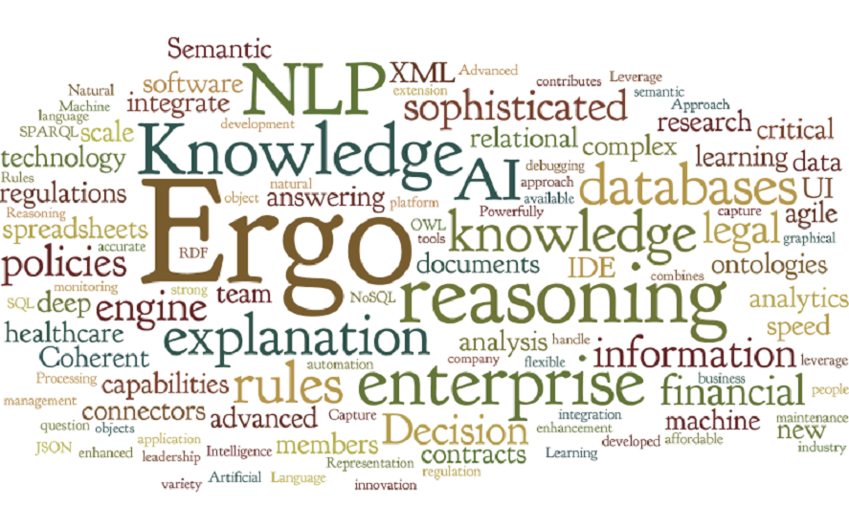
ERGO / Flora-2 Choice
A rules language provides for the control and expressivity needed
A review of available languages shows that there are limited choices that are both sufficiently expressive and operationally practical
Flora-2 (Now ERGO) has proved to meet all the requirements, including a formal grounding
Supports F-Logic (Frames) & HiLog (Higher order logic), LP (logic programming) & Transaction Logic
However, it is not a standard. For our purposes precision & usefulness is more important that being a standard
There may be other languages that will work, if so, the ERGO grounding will make an excellent reference
ERGO will provide an executable reference implementation, it is TBD if it will be practical for enterprise use
Freely available (Ergo-Lite / Flora-2 is open source)
References
ERGO: http://coherentknowledge.com/product-overview-ergo-suite-platform/
Flora-2: http://flora.sourceforge.net/ (Open source)

Slide 9
How ERGO is used
Only a few constructs are mapped to ERGO using “Code”
This includes
Support for naming & namespaces
Instance of
Facts: Associations and characteristic Instances
Based on mapping these basic “facts”, ERGO rules are used to represent SMIF semantics
Ergo
Rules
Model “Source” (e.g. UML or OWL)
SMIF Model
Ergo Facts
(Instances)
Ergo Semantics
Gen
Gen

Slide 10
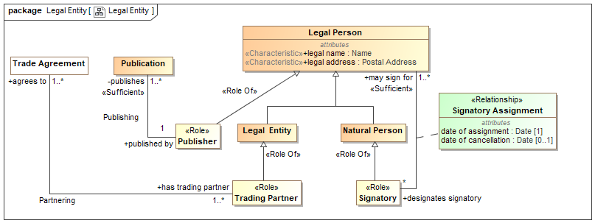
Example Model (Extended from FIBO)
OWL Concepts are made more conceptual and extended for a stakeholder

Slide 11
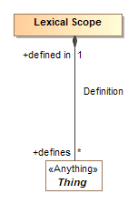
Names & Lexical Scope Prefixes in ERGO
SMIF Model
https://model.modeldriven.org/Examples/LegalEntity
Full URI
Prefix Separator
ERGO Term
LegalEntity#TradeAgreement
Prefix
Associations and classes are also Lexical Scope
Partnering#agreesTo
ERGO Statement defining prefix
:- iriprefix{LegalEntity = 'https://model.modeldriven.org/Examples/LegalEntity//'}.

Slide 12
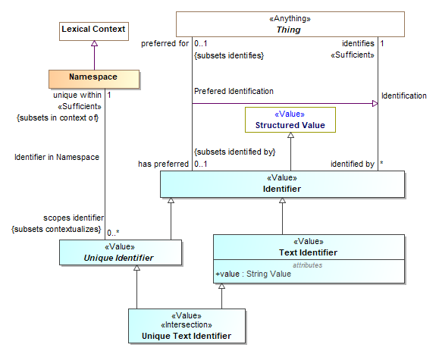
SMIF Preferred identifiers and namespaces are used for ERGO Terms
Namespaces (a thing and a Lexical Scope) may be nested to any level

Slide 13
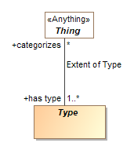


Types and Instances in ERGO
ERGO Assertion
Agreements#AcmeAgreement1234 : LegalEntity#TradeAgreement .
ERGO “Instance Of”

Slide 14
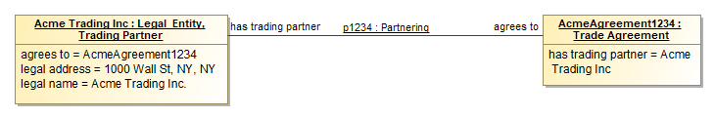
Frames based on fact instances
There is a company: “Acme Trading Partners”
Acme trading partners has a Partnering association (instance) where they have agreed to “AcmeAgreement1234”
p1234:LegalEntity#Partnering [
Partnering#agreesTo -> Agreements#AcmeAgreement1234,
Partnering#hasTradingPartner > Entities#AcmeTradingInc:LegalEntity#TradingPartner].

Slide 15
Understanding Fact instances
There is a company: “Acme Trading Partners and trade agreement “AcmeAgreement1234”
Fact “p1234”: Acme trading partners participates in a Partnering association (instance) where they have agreed to “AcmeAgreement1234”
The fact has a type – the association.
ERGO
Each “end” property is has a value
Role type of Acme can be asserted.
This “fact” has an identity – can be tracked and/or contextual
p1234 : LegalEntity#Partnering [
Partnering#agreesTo -> Agreements#AcmeAgreement1234,
Partnering#hasTradingPartner > Entities#AcmeTradingInc : LegalEntity#TradingPartner].
Each “end” property is identified

Slide 16
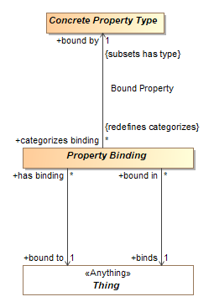

Property Bindings as instances of Property Types
p1234 : LegalEntity#Partnering [
Partnering#agreesTo -> Agreements#AcmeAgreement1234,
Partnering#hasTradingPartner > Entities#AcmeTradingInc : LegalEntity#TradingPartner].
ERGO Binding

Slide 17
Defining the association – just more association instances
ERGO
ERGO
// Define Association Type 'LegalEntity#Partnering’.
LegalEntity#Partnering:Associations#AssociationType[
Partnering#agreesTo => LegalEntity#TradeAgreement,
Partnering#hasTradingPartner => LegalEntity#TradingPartner].
/. Define the property (end) type
LegalEntity#Partnering[Definition#defines->Partnering#agreesTo].
Partnering#agreesTo : Properties#OwnedPropertyType.
// Property Range 'agreesTo#_PropertyRange_1’.
agreesTo#_PropertyRange_1:Properties#PropertyRange[
PropertyRange#hasRange -> LegalEntity#TradeAgreement,
PropertyRange#rangeOf -> Partnering#agreesTo].
Take away: It is association and property instances “all the way down” – (at all meta levels). The ergo semantics module translates these “facts” into logical predicates.

Slide 18
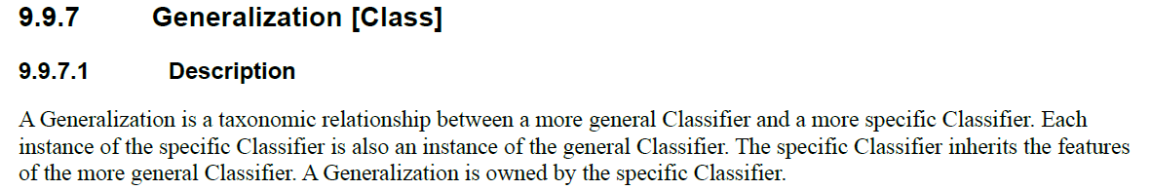
Example: Generalization
Vehicle
What does this mean?
Car
From UML 2.5 Specification:
“Every instance of Car is an instance of Vehicle”
“All cars are vehicles”
“Cars are vehicles”
How can we ensure more uniform interpretation of the spec?
Source: Conrad Bock, SysML-2 Semantics

Slide 19
Formal Semantics
Vehicle
Using Modeling
Language
Model
Car
«interpretedAs»
«interpretedAs»
Interpreting the
Model
«interpretedAs»
subset of
Things
Being Modeled
‘Real World’
Source: Conrad Bock, SysML-2 Semantics

Slide 20
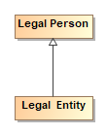
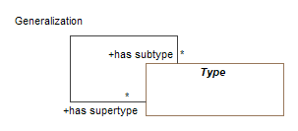
“Meta” example – Generalization -> ERGO
SMIF Model Generalization
UML Generalization “Fact”
Maps To Instance Of
Fact is an generated association instance.
In instance of Generalization defined in SMIF
Maps To
Is processed by ERGO rule in manually produced “Ergo Semantics”
LegalEntity_LegalEntity#LegalEntity_hasSupertype_LegalPerson:Types#Generalization[
Generalization#hasSubtype -> LegalEntity#LegalEntity:Types#Type,
Generalization#hasSupertype -> LegalEntity#LegalPerson:Types#Type].
Facts can be contextual, but we will not think about that yet..
?subtype :: ?supertype :- ?proposition:Types#Generalization[
Generalization#hasSubtype -> ?subtype,
Generalization#hasSupertype -> ?supertype ], inContext(?proposition).
Implies ERGO Formal Semantics
LegalEntity#LegalEntity :: LegalEntity#LegalPerson.
ERGO Supertype

Slide 21
Logical Expressions
Literals in rule bodies can be combined using , and ; (alternatively: and and or)
head :- a, (b or c).
Connectives , (and) and ; (or) can be used inside molecules:
a[b -> c and d -> e ; f -> h].
“,” binds stronger than “;”. The above is the same as
a[b -> c, d -> e] ; a[f -> h].
Negation is naf. Can be also used inside molecules:
?- a[not b -> c, d -> e ; f -> h].

Slide 22
Federation Engine ™ Implementation Preview
SMIF
UML Models
API Generated from SMIF Model by API
Java API
Eclipse UML
UML
Facet
RDF/OWL
Facet
ERGO Facet
Java
Facet
Implements SMIF Semantics as Java code
Java
Rules
Each facet provides an adapter between external data and a SMIF counterpart at any meta-level. A SMIF Object may have multiple facets.
Mappings & federations are (conceptually) between SMIF objects.
Formal Semantics
“SMIF Full”
RDF Repository
ERGO
(Flora-2)
Rules
Engine
Planned
SQL
Facet
XML
Facet
“Flat”
Facet
XMI
Facet
Analytics

Slide 23
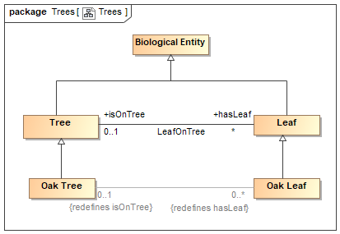
Example model

Slide 24
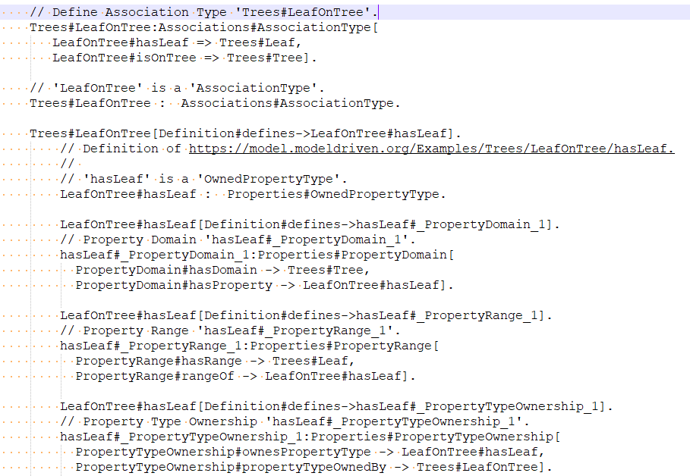
ERGO Facts are generated for model

Slide 25
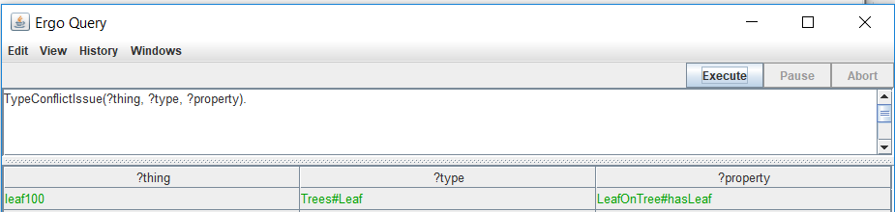
Test fact
#include "Ergo/Examples/Examples_package.ergo“
#include "SmifErgoSemantics.ergo“
inContext(KSMIFImplModelTestModelUml_Model#Examples).
inferenceSemantics(Trees#Tree).
Fact1:Trees#LeafOnTree[ LeafOnTree#hasLeaf -> leaf100, LeafOnTree#isOnTree -> tree12].

Slide 26
Java Representation

Slide 27
Generalization, Java Representation
SMIF Model Generalization
UML Generalization “Fact”
Maps To Instance Of
Maps To
public interface LegalEntity extends LegalPerson {…

Slide 28
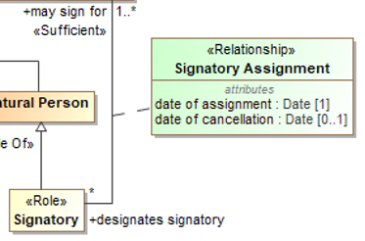
Java Interface for Signatory Assignment
public interface SignatoryAssignment extends ...Associations.Association {
...
public static SignatoryAssignment make_SignatoryAssignment(
…Resourced resource,
...LegalEntity.Date dateOfAssignment_value,
...LegalEntity.Date dateOfCancellation_value,
...Signatory designatesSignatory_value,
...LegalPerson maySignFor_value ) throws ModelException;
...
public ...Date getValue_dateOfAssignment()
public ...Date getValue_dateOfCancellation();
void set_dateOfCancellation(...LegalEntity.Date dateOfCancellation_value);
...
}

Slide 29

Java interface for Legal Person
public interface LegalPerson extends ...TopLevel.Entity { …
public static final String LegalPerson_TYPE = ".../LegalEntity/LegalPerson";
public static LegalPerson make_LegalPerson(Resourced resource);
public ...LegalEntity.PostalAddress get_legalAddress()
public ...LegalEntity.LegalPerson.legalAddress_Interface traverse_legalAddress()
public ...LegalEntity.LegalPerson.legalAddress_Interface set_legalAddress(Resourced resource,
...LegalEntity.PostalAddress value)
public ...LegalEntity.Name get_legalName()
public ...LegalEntity.LegalPerson.legalName_Interface traverse_legalName()
public ...LegalEntity.LegalPerson.legalName_Interface set_legalName(Resourced resource,
...LegalEntity.Name value)
public Iterator<...LegalEntity.Signatory> getAll_designatesSignatory()
public Iterator<...LegalEntity.SignatoryAssignment.designatesSignatory_Interface> traverseAll_designatesSignatory()
…}

Slide 30
F-Logic & HiLog
From “Programming Knowledge with Frames and Logic”, Michael Kifer
http://flora.sourceforge.net/tutorial.html

Slide 31

Relationship to Standard Logic (cont’d)
First-order flavor vs. logic programming flavor.
F-logic programming
F-logic
Logic
programming
Predicate
logic

Slide 32

Relationship to Description Logic
A description logic subset can be developed in F-logic
[Balaban 1995, The F-logic Approach for Description Languages]
F-logic
Description F-Logic
Description Logic
Predicate
logic

Slide 33
F-logic: Simple Examples
Object Id
Attribute
Object description:
John[name −> ‘John Doe’, phones -> {6313214567, 6313214566},
children -> {Bob, Mary}]
Mary[name −> ’Mary Doe’, phones -> {2121234567, 2121237645},
children -> {Anne, Alice}]
Structure can be nested:
Sally[spouse -> John[address -> ‘123 Main St.’] ]
Attribute

Slide 34
Examples (cont’d)
Historic notes:
The original F-logic distinguished between functional (->) and set-valued (->>) attributes
In FLORA-2 this has been simplified and generalized:
Only set-valued methods and only -> are used
Can specify cardinality constraints. The constraint {0:1} corresponds to functional attributes
In F-logic, variables were denoted by capitalized symbols
In FLORA-2 variables are preceded with a ?.
Constants can start with lowercase or uppercase – does not matter:
John, betty.

Slide 35
Examples (contd.)
ISA hierarchy:
John : Person - class membership
Mary : Person
alice : Student
Student :: Person - subclass relationship
Student : EntityType
Person : EntityType
Class & instance at the same time

Slide 36
Examples (Contd.)
Methods: like attributes, but take arguments
?P[ageAsOf(?Year) −> ?Age] :-
?P:Person, ?P[born −> ?B], ?Age \is ?Year–?B.
Attributes can be viewed as methods with no arguments
Query:
John’s children who were born when he was 30+ years old:
?– John[born -> ?Y, children -> ?C],
?C[born -> ?B], ?B > ?Y+30.
or
?– John[ageAsOf(?Y) −> 30, children −> ?C],
?C[born −> ?B], ?B>?Y.

Slide 37
Examples (Contd.)
Type signatures: Define the types for method
arguments and for their results
Person[born => \integer,
ageAsOf(integer) => \integer,
name => \string,
address => \string,
children => person].
Signatures can be queried:
?- Person[name => ?Type].
Answer: ?Type = \string
?- Person[?Attr => \string].
Answer: ?Attr = name
?Attr = address
Note: builtin types, like \integer, start with a backslash.

Slide 38
Model Theory for Object Definitions
Simplified (so-called Herbrand) semantics:
Universe: HB – set of all variable-free terms (“ground” terms)
Interpretation: I = (HB,I->,∈,<)
where < : partial order on HB
∈ : binary relationship on HB
I-> : HB → (HB → powerset(HB))
Satisfaction of formulas in I:
I |= o[m->v] if v ∈ I->(m)(o)
I |= o:c if o ∈ c
I |= c::s if c < s
methods
partial
values
objects

Slide 39
Model Theory for Types
Added
Interpretation: I = (HB,I->, ∈,<, I _{=>})
where I=> : HB → (HB → powerset(HB))
Satisfaction of method signatures:
I |= c[m=>t] if some element in I=>(m)(c) is ≤ t
Basically, we want c[m=>t] and t::t’ to imply c[m=>t’]
(if the result is of type t then it also conforms to any supertype of t)
partial
The function assigns types to methods
set of methods
set of classes
types for results

Slide 40
Semantics (cont’d)
The well-typing condition:
o[m −> v] is well-typed in I
iff whenever o ∈ c then v ∈ (I_{=>}(m)(c))
I is well-typed if every true object atom is well-typed.
Here we want c[m => t], o[m -> v], o:c to imply v:t.
I.e., typing is a constraint

Slide 41
Semantics (cont’d)
I |= P /\ Q iff I |= P and I |= Q
I |= P \/ Q iff I |= P or I |= Q
I |= ¬P iff not I |= P
I |= ∀?X P iff for all c ∈ HB, I |= P’
P’ is P with all free occurrences of ?X replaced with c
I |= ∃?X P iff for some c ∈ HB, I |= P’
P’ is P with some free occurrence of ?X replaced with c

Slide 42
HiLog
Allows certain forms of logically clean meta-programming
Syntactically appears to be higher-order, but semantically is first-order and tractable
Has sound and complete proof theory
[Chen,Kifer,Warren, HiLog: A Foundation for Higher-Order Logic Programming, J. of Logic Programming, 1993]
The recent work on SKIF and Common Logic (Hayes et. al.) is a rediscovery of HiLog with very minor differences – 12 years later!

Slide 43
Examples of HiLog
Variables over predicates and function symbols:
p(?X,?Y) :- ?X(a,?Z), ?Y(?Z(b)).
Variables over atomic formulas (reification):
call(?X) :- ?X.
A use of HiLog in FLORA-2 (e.g., querying of schema):
?O[unaryMethods(?Class) -> ?M] :-
?O[?M(?) ->?V], ?V:?Class.
Meta-variable: ranges over method names

Slide 44
Syntax and Semantics of HiLog
In predicate logic, predicates and functions are disjoint, but predicate expressions (atomic formulas) and functional expressions (function terms) have the same syntax: e.g., p(?X, f(a,b)) vs. g(?X,f(a,b))
HiLog makes no distinction between predicates and function symbols and atomic formulas are indistinguishable from function terms

Slide 45
Relationship to Predicate Logic
|=_{classical} ψ implies |=_{hilog} ψ
|=_{hilog} ψ does not imply |=_{classical} ψ:
(q(a) <-> r(a)) <- ∀X∀Y(X=Y)
is valid in HiLog but not in predicate logic
But:
|=_{hilog} ψ implies |=_{classical} ψ , except for formulas that are true in every interpretation with at least γ elements in the domain (for some γ >0), but are false in some interpretation that has less than γ elements [Chen,Kifer,Warren JLP-93].
Examples: Horn clauses without “=” in the head;
Any set of “=”-free formulas

Slide 46
Reification: An Application of HiLog to F-logic
Reification: makes an object out of a statement:
john[believes -> ${mary[likes -> bob ]} ]
Introduced in [Yang & Kifer, ODBASE 2002]
Object made out of the statement
mary[likes -> bob]
Main idea:
- Extend the syntax of F-logic to allow terms of the form
${mary[likes -> bob ]}, ${bob[name -> ‘Bob Doe’ ]}
and even more general ones, like
${mary[likes -> bob, name -> ‘Bob Doe’ ]}
- Eliminate the distinction between atomic formulas and terms both
in the syntax and semantics (like in HiLog)

